Slide 1


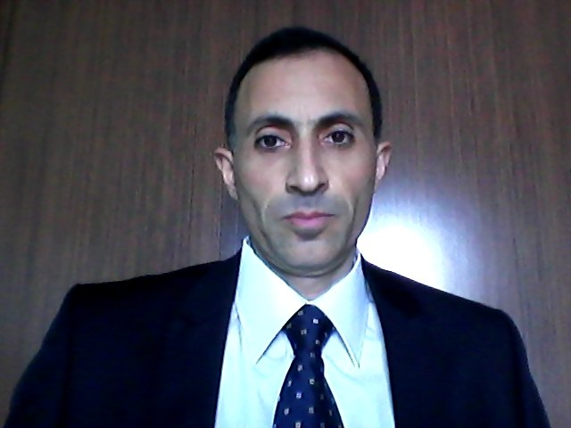
.
EŞŞAFİHU ANTİCANCER TREATMENT AND MEDİCİNE
MEDİCAL NEBEVİ METHOD
ANTİCANCER DRUG HU
WE HAVE TO CUT OFF AMONG MACROPHAGES AND CANCER CELL
İNFLAMATORİAL RELATİONSHİP , DEEP-STRONG METABOLİC
OXİDATİVE STRESS CONDİTİON ,HİGH LEVEL CALCİUM MOBİLİSATİON ,
AND HİGH AMOUNT WASTE PRODUCT LACTİC ACİD
SHOULD HAVE BEEN CORRECTED FOR HOMEOSTATİC BALANCED
TO CONTİNUE MOLECULAR CELLULAR VİTAL FUNCTİONS
AS PHYSİOLOGİC
EFRUZ ASİLOĞLU
ANTİCANCER
CANCER DRUG HU
THEORETİCİAN DİSCOVERER
HİGHLY
TRULY
ORİGİNAL
28.07.2013

