Slide 1
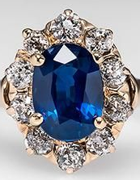

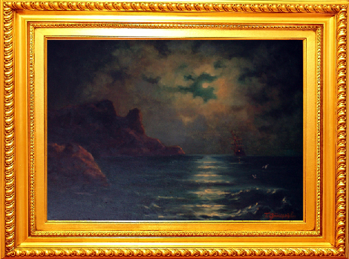

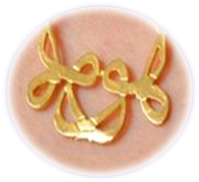

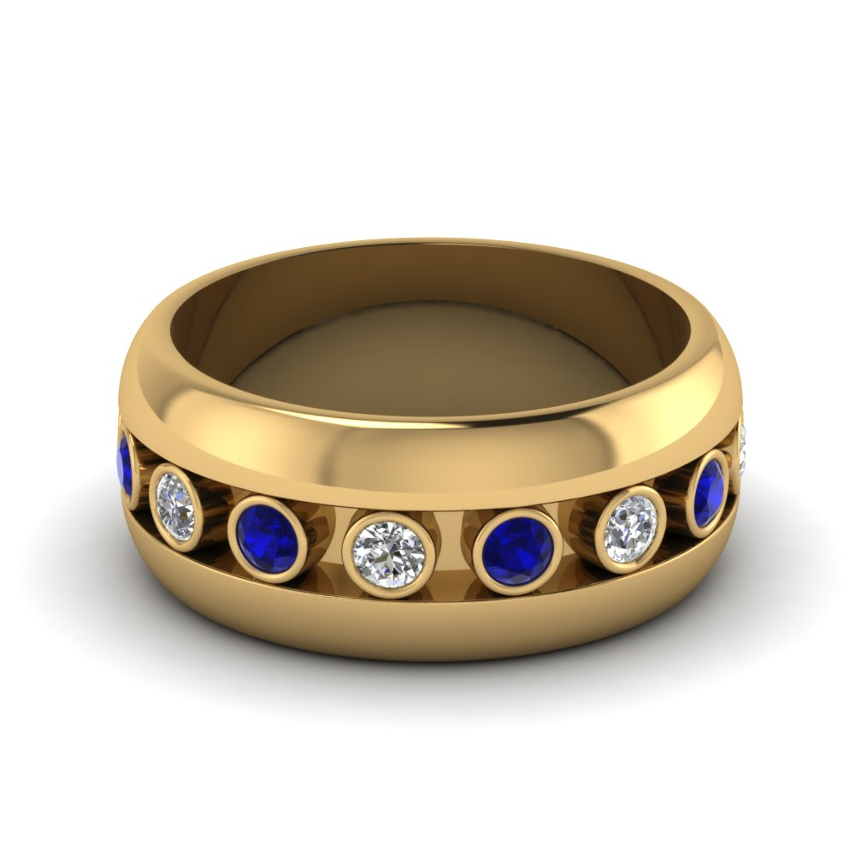
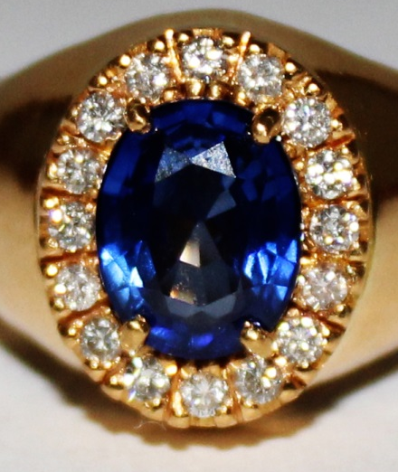


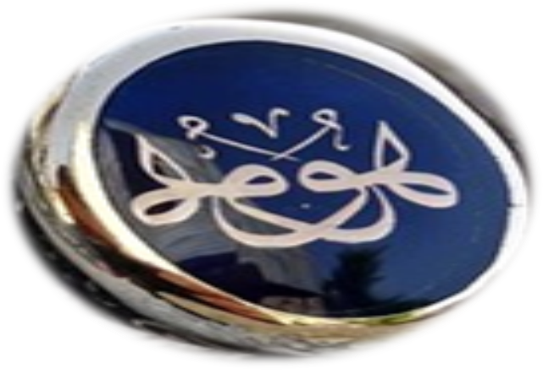
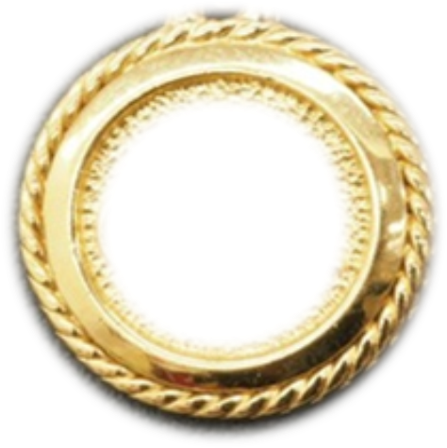
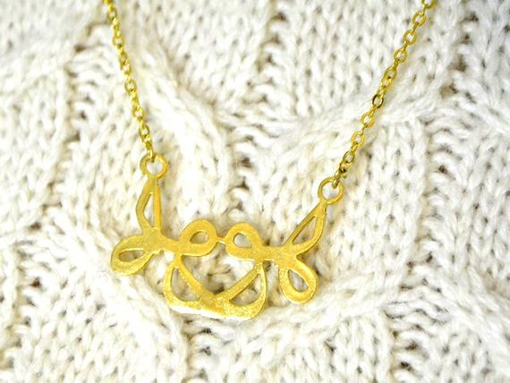
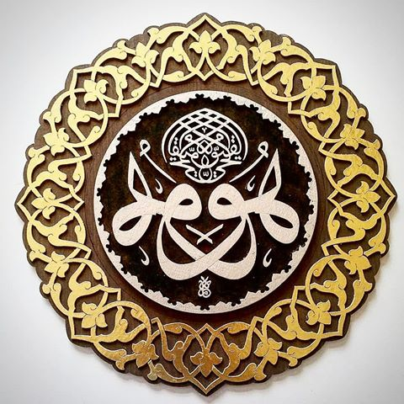
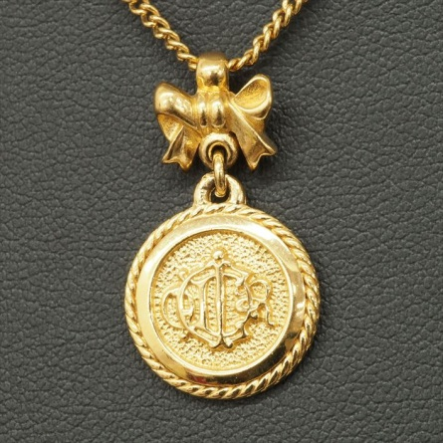
.
EFRUZHU CONVENTIONAL CANCER THERAPY FINISHED PROTOCOL
1.NF-KB INHIBITORS + ANTIINFLAMMATION
2.DNMT + HDAC İNHIBITORS
3.GLYCOSAMINOGLYCAN
4.ELECTROLYTE + HİGH ENERGY + ANTIOXIDANT + SIGNALING

